Slide 1
Principles of Computing CPEG 110 Dr. Zubair Shah

Slide 2
About me
My name is Zubair Shah
Assistant Professor in CSE@HBKU
PhD in Computer Science
Major: Artificial Intelligence
Email: zshah@hbku.edu.qa
Office Hours:
Email: Anytime, I usually reply within 24 hours except during weekend. Please remind me if you do not get reply.
Meeting: Office is in LAS Building, Room A101-F, time: please drop by any time before class on Tuesday
Profile: https://scholar.google.com/citations?user=WOpOkdMAAAAJ&hl=en

Slide 3
About Course
Contents
Mostly Python 3 programming with some basics about computers, number systems and Boolean logic
Outcome
Fluency in (Python) procedural programming
Usage of assignments, conditionals, and loops
Ability to create Python modules and programs
Competency in object-oriented programming
Ability to recognize and use objects and classes
Knowledge of searching and sorting algorithms
Knowledge of basics of vector computation
Delivery
Two classes every week
Theory: slides presentations, Practical: Jupyter Notebook
Slides will be available through Canvas
Textbook: Think Python, 2nd Ed. by Allen Downey
PDF available freely through: https://greenteapress.com/thinkpython2/thinkpython2.pdf

Slide 4
About Course continue…
How to succeed
We know that you care about grades
Students can do well regardless of experience
But you may have to work hard!
If no experience, budget 10 hours of homework a week
Assessment Method
Assignments and Quizzes
20%, few assignments, and quizzes throughout the entire course
Midterm
30%, midterm will be after mid-semester break and will be from course covered
Final term
30%, final term will be in 15th or 16th week and will be from the portion of course covered after midterm
Lab Project
20%, Two mini software like programs that students need to write Python code for
Class participation
Attendance is mandatory, attend all classes
Avoid disturbance in class and participate in class discussion

Slide 5
Outline
This week we will try to cover the following topics
Part 1:
Some basic Introduction to computing
Part 2:
Introduction to Number systems
Part 3:
Basics of Boolean logic

Slide 6
Part 1: Introduction to Computing

Slide 7
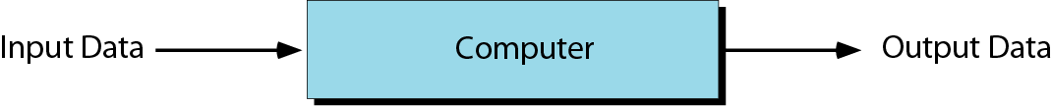
Data processor model

Slide 8
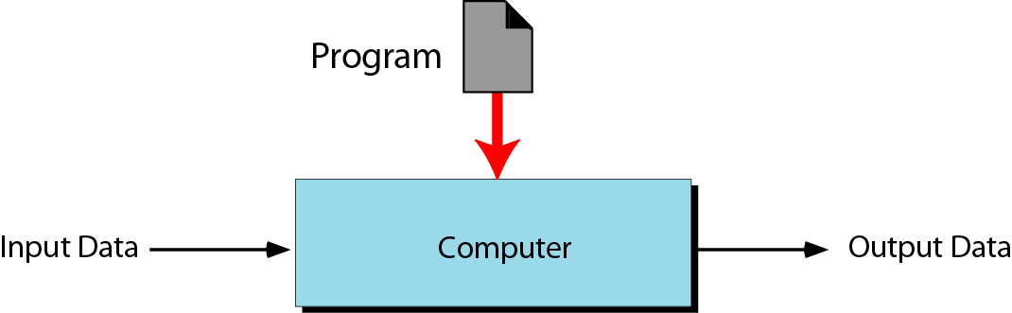
Programmable data processor model
Computers – general-purpose machines

Slide 9
Program
A program
is a set of instructions that tells the computer what to do with data.
written in a computer language.

Slide 10
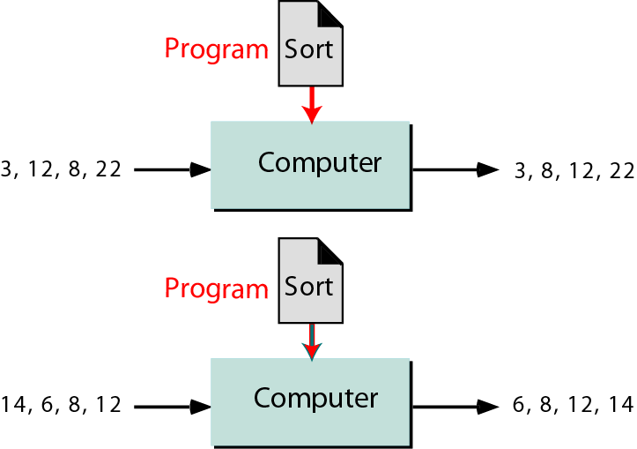
Same program, different data

Slide 11
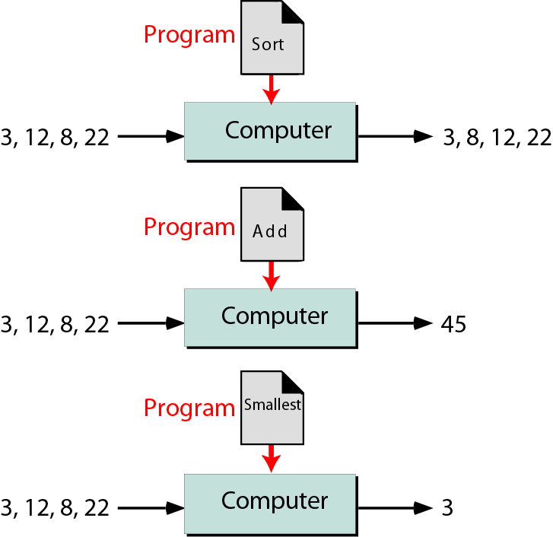
Different program, same data

Slide 12
Von Neumann Model
Every computer today is based on the von Neumann Model.
It is based on 3 ideas:
Four subsystems
Stored Program Concept
Sequential Execution of Instructions

Slide 13
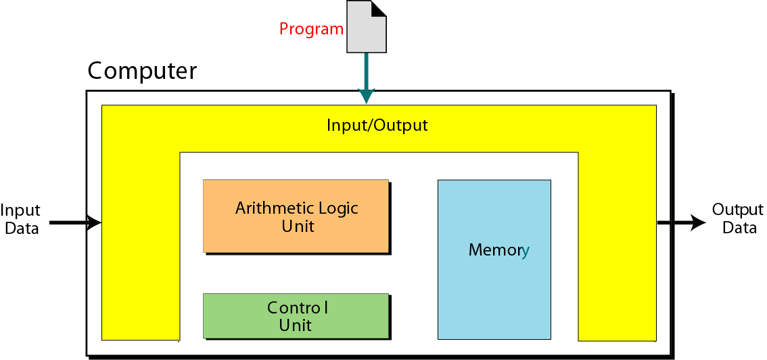
Von Neumann Model
Four subsystems:
Memory – the storage area of programs and data
ALU – arithmetic/logic unit, where operations take place
Control Unit – control Memory, ALU, and I/O
I/O – accept input data/send output data
Figure A

Slide 14
Input/output Subsystem
The definition is very broad;
it includes the secondary storage devices.
Disk – stores data and programs for processing

Slide 15
Stored Program Concept
The von Neumann model states that the program must be stored in memory
The memory of modern computers hosts both
a program
its corresponding data

Slide 16
Sequential Execution of Instructions
A program is made of a finite number of instructions.
The control unit
fetches one instruction from memory
interpret it
execute it
The instructions are executed one after another.

Slide 17
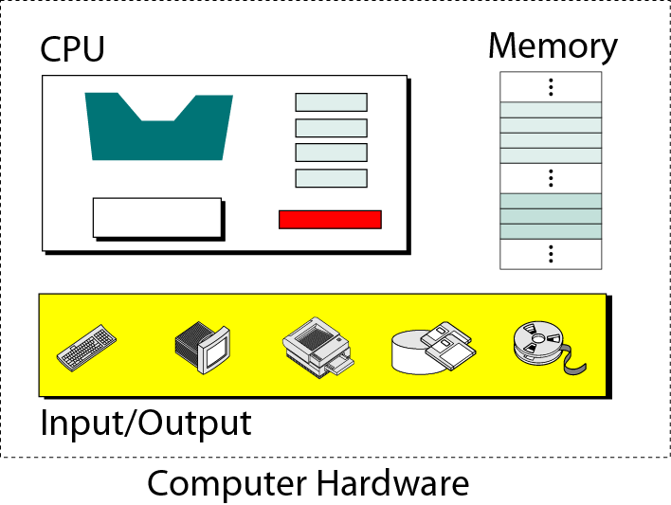
ALU
Registers
Control unit

Slide 18
Storing Data
Store data in the form of an electrical signal, specially its presence or absence.
This implies that a computer can store data in one of two states.
0 and 1
Binary number system

Slide 19
Data organization
Although data should be stored only in one form (a binary pattern) inside a computer,
data outside a computer can take many forms.
Data come in different forms:
Numbers
Text
Images
Audio
Video

Slide 20
Requirements of von Neumann model
The programs must be stored in memory. (Fig. A on next slide)
The programs must be a sequence of instructions. (Fig. B on next slide)

Slide 21
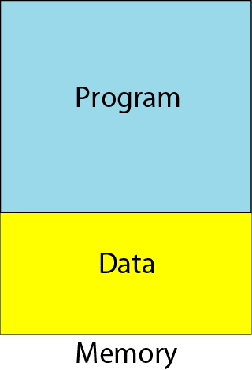
Program and data in memory
Figure A

Slide 22
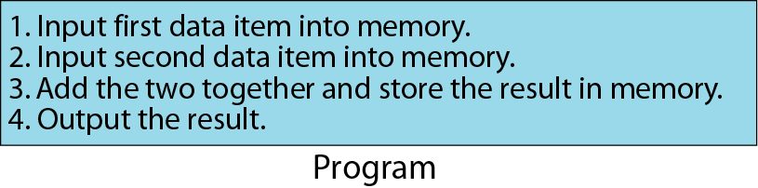
Program made of instructions
Figure B
Fig. 1.7 Program made of instructions

Slide 23
Part 2: Introduction to Number Systems

Slide 24
Numbering Systems
We are all familiar with the decimal number system (Base 10).
892 is a decimal number
The digit are always from 0 to 9
10 Digits and hence base 10 number system
Some other number systems that we will work with are:
Binary → Base 2
Octal → Base 8
Hexadecimal → Base 16

Slide 25
Characteristics of Numbering Systems
The digits are consecutive.
The number of digits is equal to the size of the base.
Zero is always the first digit.
The base number is never a digit.
When 1 is added to the largest digit, a zero and a carry of one results.
Numeric values are determined by the implicit positional values of the digits.

Slide 26
Decimal Number System
Also called the “Base 10 system”
For instance, (192)₁₀
We often omit the base 10 and simply write 192
This is the most common number system that we use routinely

Slide 27
Binary Number System
Decimal is base 10 and has 10 digits: 0,1,2,3,4,5,6,7,8,9
Binary is base 2 and has 2 digits:
0,1
For a number to be in a given base number system, it can only contain the digits in that base, which range from 0 up to (but not including) the base.
What bases can these numbers be in? 122, 198, 178, E1A4
9

Slide 28
Binary Number System
Also called the “Base 2 system”
The binary number system is used to model the series of electrical signals computers use to represent information
0 represents the no voltage or an off state
1 represents the presence of voltage or an on state

Slide 29
Binary Numbering Scale
Base 2 Number | Base 10 Equivalent
000 | 0
001 | 1
010 | 2
011 | 3
100 | 4
101 | 5
110 | 6
111 | 7

Slide 30
Octal Number System
Also known as the Base 8 System
Uses digits 0 - 7
Readily converts to binary
Groups of three (binary) digits can be used to represent each octal digit
Also uses multiplication and division algorithms for conversion to and from base 10

Slide 31
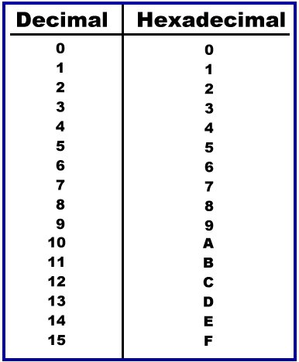
Hexadecimal Number System
Base 16 system
Uses digits 0-9 &
letters A,B,C,D,E,F
Groups of four bits represent each base 16 digit

Slide 32
Significant Digits
Binary: 11101101
Most significant digit Least significant digit
Hexadecimal: 192
Most significant digit Least significant digit

Slide 33
Positional Values of the numbers
The position of the number represents its value
For instance, in decimal number 192
we call 1 as 100, 9 as 90 and 2 as 2
Like we say one hundred nighty two
Positional values increases from
right to left or
lest significant digit to most significant digit
For instance
10³ 10² 10¹ 10⁰

Slide 34
Division Algorithm
The easiest way to convert a decimal number to its equivalent number in any other number system, we use
Division Algorithm
This method repeatedly divides a decimal number by the base of the target number system and records the quotient and remainder
The remainder digits form the target number system equivalent in least significant to most significant digit sequence

Slide 35
Decimal to Binary Conversion
The easiest way to convert a decimal number to its binary equivalent is to use the Division Algorithm
This method repeatedly divides a decimal number by 2 and records the quotient and remainder
The remainder digits (a sequence of zeros and ones) form the binary equivalent in least significant to most significant digit sequence

Slide 36
Decimal to Binary Conversion Division Algorithm
Convert 47 to its binary equivalent:
47₁₀ = x₂
Step 1: 47 / 2 = 23 R 1 Divide 47 by 2. Record quotient in next row
Step 2: 23 / 2 = 11 R 1 Again divide by 2; record quotient in next row
Step 3: 11 / 2 = 5 R 1 Repeat again
Step 4: 5 / 2 = 2 R 1 Repeat again
Step 6: 2 / 2 = 1 R 0 Repeat again
Step 7: 1 / 2 = 0 R 1 STOP when quotient equals 0
1 0 1 1 1 1₂

Slide 37
Decimal to Octal Conversion Division Algorithm
Convert 47 to its Octal equivalent:
47₁₀ = x₈
Step 1: 47 / 8 = 5 R 7 Divide 47 by 8. Record quotient in next row
Step 2: 5 / 8 = 0 R 5 STOP when quotient equals 0
5 7₈

Slide 38
Decimal to Hexadecimal Conversion Division Algorithm
Convert 47 to its hexadecimal equivalent:
47₁₀ = x₁₆
Step 1: 47 / 16 = 2 R 15 = F Divide 47 by 2. Record quotient in next row
Step 2: 2 / 16 = 0 R 2 STOP when quotient equals 0
15 = F in Hexadecimal
2 F₁₆

Slide 39
Multiplication Algorithm
The easiest method for converting any number in other number system to its decimal equivalent is to use the
Multiplication Algorithm
It requires to multiply the Source number digits by increasing powers of the base of the source number, starting from the right
Then, to find the decimal number equivalent, sum those products

Slide 40
Binary to Decimal Conversion Multiplication Algorithm
Convert (101111)₂ to its decimal equivalent:
Binary 1 0 1 1 1 1
Positional Values
x
x
x
x
x
x
2⁵
2⁴
2³
2²
2¹
2⁰
Sum of Products
(1x32) + (0x16) + (1x8) + (1x4) + (1x2) + (1x1)
(32) + (0) + (8) + (4) + (2) + (1)
47₁₀

Slide 41
Octal to Decimal Conversion Multiplication Algorithm
Convert (57)₈ to its decimal equivalent:
Octal 5 7
Positional Values
x
x
8¹
8⁰
Sum of Products
(5x8) + (7x1)
(40) + (7)
47₁₀

Slide 42
Hexadecimal to Decimal Conversion Multiplication Algorithm
Convert (2F)₁₆ to its decimal equivalent:
Hexadecimal 2 F
Positional Values
x
x
16¹
16⁰
Sum of Products
(2x16) + (Fx1)
(32) + (F)
(32) + (15)
47₁₀

Slide 43
Conversion between other number systems
We still need conversion between
Binary to Octal and Octal to Binary
Binary to Hexadecimal and Hexadecimal to Binary
Octal to Hexadecimal and Hexadecimal to Octal
There are two ways to perform these conversions
Indirect
Direct

Slide 44
Indirect Conversion
All these conversions (e.g., from binary to octal etc.) can be performed using the concepts we just learned, that is using
Division algorithm, and
Multiplication Algorithm
For example, binary to octal conversion can be perform as follows
Convert binary number to decimal using Multiplication Algorithm
Convert that decimal to octal number using division algorithm
E.g.,
(101111)₂ = X₈
(101111)₂ = (47)₁₀ using multiplication algorithm (see previous slides)
(47)₁₀ = (57)₈ using division algorithm (see previous slides)
(101111)₂ = (57)₈

Slide 45
Direct Conversion Binary to Octal
Divide each binary number into group of 3 digits, from right to left,
Add zeros to complete group at left most position if group is incomplete
Convert each group of 3 digits into octal
Combining the number will give the desired octal number
Lets take (101111)2 = X₈
101 111
5 7
(57)₈
Binary | Oct
000 | 0
001 | 1
010 | 2
011 | 3
100 | 4
101 | 5
110 | 6
111 | 7

Slide 46
Direct Conversion Octal to Binary
This is the reverse process of what we just did
Divide each octal number into separate digits, from right to left,
Convert each digit into binary using 3 binary digits
Combining the number will give the desired binary number
Lets take 57₈ = (X)₂
5 7
101 111
(101111)₂
Binary | Oct
000 | 0
001 | 1
010 | 2
011 | 3
100 | 4
101 | 5
110 | 6
111 | 7

Slide 47
Direct Conversion Binary to Hexadecimal
Binary | Hexa
0000 | 0
0001 | 1
0010 | 2
0011 | 3
0100 | 4
0101 | 5
0110 | 6
0111 | 7
1000 | 8
1001 | 9
1010 | A
1011 | B
1100 | C
1101 | D
1110 | E
1111 | F
The process is like octal conversion, except we need group of 4 digits
Divide each binary number into group of 4 digits, from right to left,
Add zeros to complete group at left most position if group is incomplete
Convert each group of 4 digits into octal
Combining the number will give the desired hexadecimal number
Lets take (101111)2 = X₈
0010 1111
2 F
(2F)₁₆

Slide 48
Direct Conversion Hexadecimal to Binary
Binary | Hexa
0000 | 0
0001 | 1
0010 | 2
0011 | 3
0100 | 4
0101 | 5
0110 | 6
0111 | 7
1000 | 8
1001 | 9
1010 | A
1011 | B
1100 | C
1101 | D
1110 | E
1111 | F
This is the reverse process of what we just did
Divide each hexadecimal number into separate digits, from right to left,
Convert each digit into binary using 4 binary digits
Combining the number will give the desired binary number
Lets take 2F₁₆ = (X)₂
2 F
0010 1111
(00101111)₂

Slide 49
Octal to Hexadecimal and back
Convert octal to binary
Binary to Hexadecimal
Example: 57₈ = (X)₁₆
Step 1: 57₈ = (X)₂
5 7
101 111
(101111)₂
Step 2: (101111)₂ = (X)₁₆
0010 1111
2 F
(2F)₁₆
57₈ = 2F₁₆
Reverse this process to convert from hexadecimal to octal

Slide 50
Part 3: Basics of Boolean Logic

Slide 51
Computing Is About Boolean Logic
The rules of the logic tell us how to manipulate inputs and produce outputs.
We define the rules so that we get answers that are useful to us.

Slide 52
Boolean Operators
NOT
P | ¬ P
True
False

Slide 53
Boolean Operators
NOT
P | ¬ P
True | False
False | True

Slide 54
Boolean Operators
AND
P | Q | P ∧ Q
True | True
True | False
False | True
False | False

Slide 55
Boolean Operators
AND
P | Q | P ∧ Q
True | True | True
True | False | False
False | True | False
False | False | False

Slide 56
Boolean Operators
OR
P | Q | P ∨ Q
True | True
True | False
False | True
False | False

Slide 57
Boolean Operators
OR
P | Q | P ∨ Q
True | True | True
True | False | True
False | True | True
False | False | False

Slide 58
Boolean Operators
IMPLIES
P | Q | P → Q
True | True
True | False
False | True
False | False

Slide 59
Boolean Operators
IMPLIES
P | Q | P → Q
True | True | True
True | False | False
False | True | True
False | False | True

Slide 60
Boolean Operators
EQUIVALENCE
P | Q | P ↔ Q
True | True
True | False
False | True
False | False

Slide 61
Boolean Operators
EQUIVALENCE
P | Q | P ↔ Q
True | True | True
True | False | False
False | True | False
False | False | True

Slide 62
Boolean Logic
P | Q | ¬P | P ∨ Q | P ∧ Q | P → Q | P ↔ Q
True | True | False | True | True | True | True
True | False | False | True | False | False | False
False | True | True | True | False | True | False
False | False | True | False | False | True | True

Slide 63
Using Boolean Logic
P | Q | ¬P
True | True
True | False
False | True
False | False
¬P ∧ ((P ∨ Q)→ Q)

Slide 64
Using Boolean Logic
P | Q | ¬P | P ∨ Q
True | True | False
True | False | False
False | True | True
False | False | True
¬P ∧ ((P ∨ Q)→ Q)

Slide 65
Using Boolean Logic
P | Q | ¬P | P ∨ Q
True | True | False | True
True | False | False | True
False | True | True | True
False | False | True | False
¬P ∧ ((P ∨ Q)→ Q)

Slide 66
Using Boolean Logic
P | Q | ¬P | P ∨ Q |  | (P ∨ Q)→ Q
True | True | False | True
True | False | False | True
False | True | True | True
False | False | True | False
¬P ∧ ((P ∨ Q)→ Q)

Slide 67
Using Boolean Logic
P | Q | ¬P | P ∨ Q |  | (P ∨ Q)→ Q | ¬P ∧ ((P ∨ Q)→ Q)
True | True | False | True |  | True
True | False | False | True |  | False
False | True | True | True |  | True
False | False | True | False |  | True
¬P ∧ ((P ∨ Q)→ Q)

Slide 68
Using Boolean Logic
P | Q | ¬P | P ∨ Q |  | (P ∨ Q)→ Q | ¬P ∧ ((P ∨ Q)→ Q)
True | True | False | True |  | True | False
True | False | False | True |  | False | False
False | True | True | True |  | True | True
False | False | True | False |  | True | True
¬P ∧ ((P ∨ Q)→ Q)

Slide 69
Booleans in Python
def chocolate():
password = input("Type your password: ")
while password != "chocolate":
password = input("Try again: ")
print("Got it!!")

Slide 70
Booleans in Python
def for_dummies():
password = input("Type your password: ")
tries = 0
while password != "chocolate" and tries < 5:
password = input("Try again: ")
tries +=1
if tries == 5:
print("Okay, you've tried hard enough")
else:
print("Got it!!")
Notes:
Load my file chocolate_password to try this.

Slide 71
Booleans in Python
def for_dummies1():
password = input("Type your password: ")
tries = 0
while not(password == "chocolate" or tries >= 5):
password = input("Try again: ")
tries +=1
if tries == 5:
print("Okay, you've tried hard enough")
else:
print("Got it!!")

Slide 72
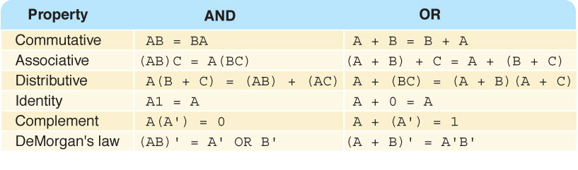
Boolean Identities
We also use:
Multiplication for AND
Addition for OR
Notes:
This is from Dale and Lewis, so keep the notation.
Point out that it is simple to prove these. We just use truth tables. Prove the first De Morgan’s law.

Slide 73
Proving Things using Truth Table
Prove the first of deMorgan’s laws:
(AB)’ = A’ + B’
¬(A ∧ B) = ¬A ∨ ¬B
A | B | A ∧ B | ¬(A ∧ B)
True | True | True | False
True | False | False | True
False | True | False | True
False | False | False | True
A | B | ¬A | ¬B | ¬A ∨ ¬B
True | True | False | False | False
True | False | False | True | True
False | True | True | False | True
False | False | True | True | True
Notes:
Emphasize that the original tables are simply definitions. Everything else is rote.

Slide 74
Proving Things using Truth Table
Prove the first of deMorgan’s laws:
¬(A ∧ B) ≡ ¬A ∨ ¬B
A | B | A ∧ B | ¬(A ∧ B)
True | True | True | False
True | False | False | True
False | True | False | True
False | False | False | True
A | B | ¬A | ¬B | ¬A ∨ ¬B
True | True | False | False | False
True | False | False | True | True
False | True | True | False | True
False | False | True | True | True
Notes:
Emphasize that the original tables are simply definitions. Everything else is rote.

Slide 75
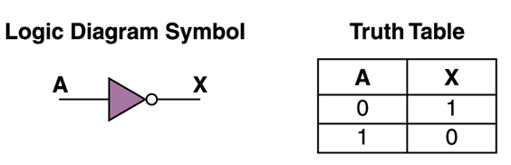
Boolean Circuits
NOT

Slide 76
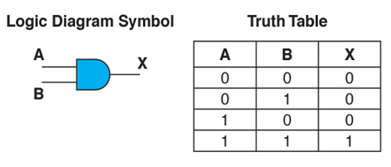
Boolean Circuits
AND

Slide 77
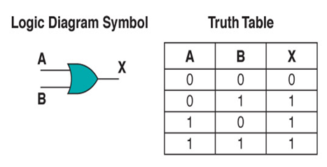
Boolean Circuits
OR

Slide 78

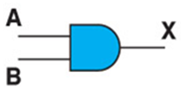
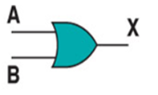
Boolean Gates
Not
And
Or

